Slide 1
The Nourishing Vocation Project
A Thriving Congregations
Project for Spiritual Renewal
and Vocational Discernment
through the Lutheran Center
for Faith, Values, and Community
at St. Olaf College
Directed by Rev. Dr. Char Rachuy Cox
stolaf.edu/nourishing-vocation

Slide 2
Tools for the Toolbox
Nourishing a Rhythm

Slide 3
Vocare Basic Practice
Values
Openness
Call
Attentiveness
Regrets
Experiences of the God’s Presence

Slide 4
Near and Now Study Guides
INTEGRATIVE STUDY GUIDE
BIBLICAL READING
REFLECTION
STORYTELLING
DISCUSSION
ACTION
VOCARE
PRAYER

Slide 5
The Called Life Exercise
Personal and Particular
Within Community
Through all of Life
For the Common Good

Slide 6
Discerning our Values
Values Template
Comprehensive List
Criteria
Affiliation Groups
Rank in Priority Order
Top 2 – Core Values Statements
Actual or Aspirational
Obstacles and Opportunities

Slide 7
Technical and Adaptive Change
 | Technical Work | Adaptive Work
THE PROBLEM | Is Obvious | Requires Listening, Learning, and Leading
THE SOLUTION | Is Obvious | Requires Listening, Learning, and Leading
WHOSE WORK IS IT? | Experts of Authority | Body of Christ
TYPE OF WORK | Quick Results Oriented | Careful/Prayerful Process Oriented
TIMELINE | ASAP | As Long as it Takes
EXPECTATIONS | Solve the Problem, and Move on | Make Progress toward Understanding and the Common Good
ATTITUDE | Right/Wrong | Curiosity, Humility, Generosity

Slide 8
Nourishing a Rhythm - Handbook

Slide 9
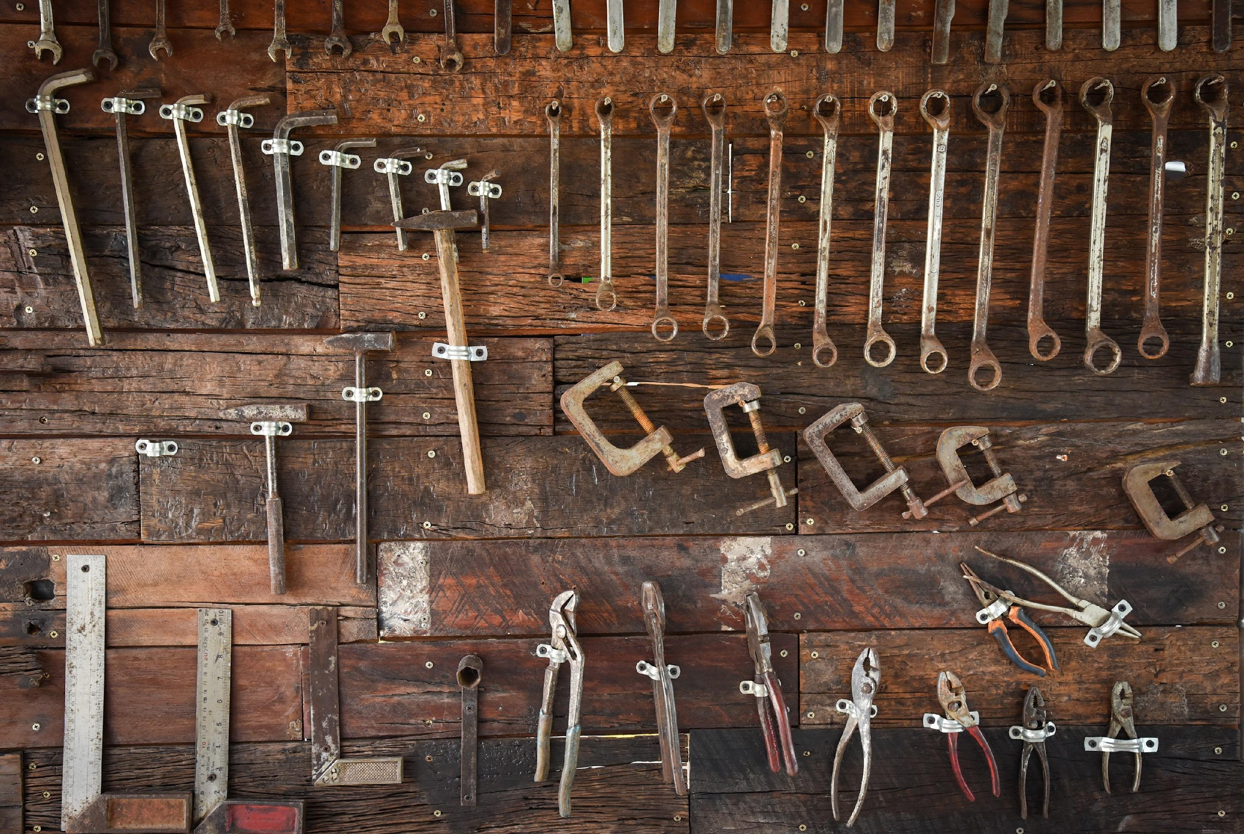
Secondary tools
Going deeper

Slide 10
Vocare Related Resources (scroll through the linked page for resources)
Liturgies
Guided Meditations
Sing Vocare!
Kid Vocare
Biblical Story Vocare
Vocare Discernment Retreat
Values Cards
Editable PowerPoint Agenda

Slide 11
My Living Faith
Exercise based on Bible stories and hymns/worship songs
Think and reflect theologically about their faith and life
Reflect upon fundamental beliefs
Consider how fundamental beliefs are encountered and expressed
Photo by James Lee on Unsplash

Slide 12
Parish Gatherings
Where have we been?
Create a VOCARE-based congregational storyline
Where are we now?
Articulate the congregation’s present life and ministry using VOCARE
Photo by Sincerely Media on Unsplash

Slide 13
Micro-Engagements
SHORT-TERM EXPERIMENTS
VALUES-BASED
DISCERNMENT-LED

Slide 14
Seasonal Worship and Devotional Resources
Advent
Lent
Ordinary Time (Summer) Suggestions

Slide 15
Conference on Worship, Theology, and the Arts

Slide 16
Who is My Neighbor?
2022 Research Projects
Podcast – The Book of Fundamentals (for healthy, productive conversations)
Mapping Minnesota: Who is My Neighbor?
Exploring Immigrant Stories of Southern Minnesota
Minnesota Immigrant Youth Resources
Guides for Congregation Research
Church Programming and Community Relations

