Slide 1
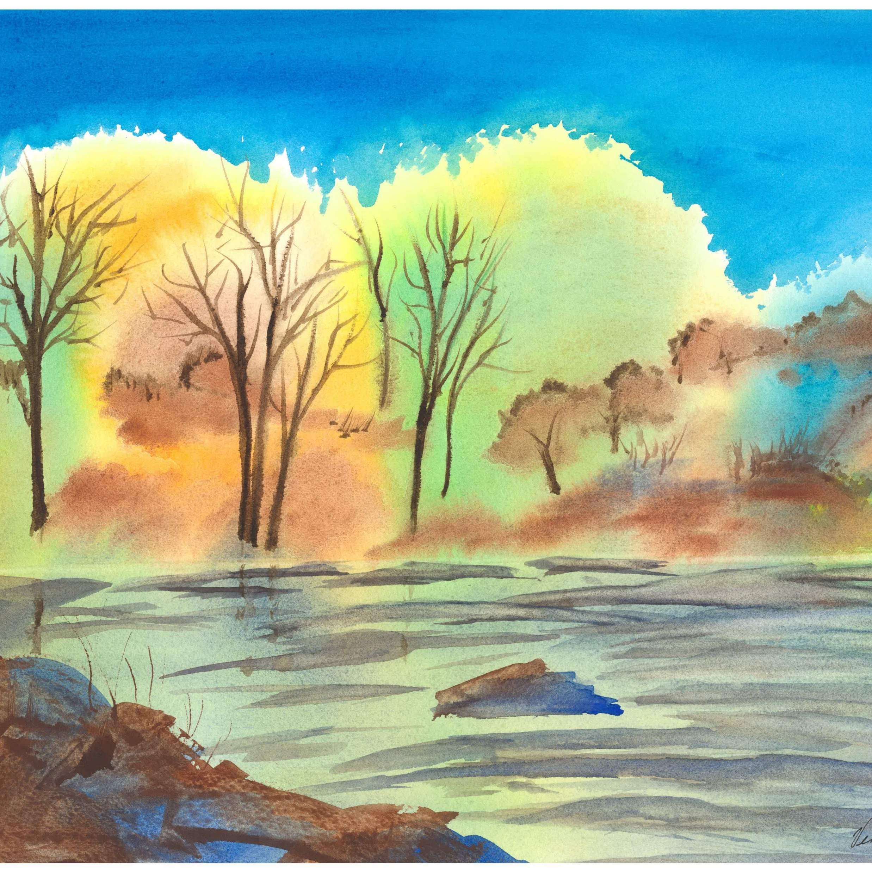
Discernment
Work of the People
Liturgy of Life

Slide 2
Story- Sharing & Story-Listening
What captures your attention?
What do you see? What do you think or Feel?

Slide 3
When you think of discernment, what comes to mind?

Slide 4
Communal
The wisdom is in the room

Slide 5
Work of the People – Liturgy of Life
Integrative Practice
Prayerfully
Reflectively
Critically
Seeks
Wisdom
Understanding
Guidance
Direction

Slide 6
That opens us to
Contextual Embodied Action
Why are we here?
What are we called to do?
Who are we called to be?

Slide 7
Postures and Practices
Openness
Curiosity
Humility
Generosity

Slide 8
Bring to mind an experience, need, or concern that you are holding right now
Make me to know your ways, O Lord; teach me your paths. Lead me in your truth, and teach me, for you are the God of my salvation; for you I wait all day long.
Psalm 25:4,5
What words or phrases captured your attention?
How are you being invited to be open in this moment?

Slide 9
Story- Sharing & Story-Listening
What captures your attention this time?
What Stories from your life does this image bring to Mind?

Slide 10
Photo by Max Harlynking on Unsplash

Slide 11
Photo by Sam Balye on Unsplash

Slide 12
Photo by Felicia Buitenwerf on Unsplash

Slide 13
Why are you here?

Slide 14
Bring to mind the community in which your ministry is located
Make me to know your ways, O Lord; teach me your paths. Lead me in your truth, and teach me, for you are the God of my salvation; for you I wait all day long.
Psalm 25:4,5
What words or phrases captured your attention?
About what are you curious?

Slide 15
Thriving Congregations
Deepen relationship with God
Enhance connections with one another
Contribute to the flourishing of our communities and world

Slide 16
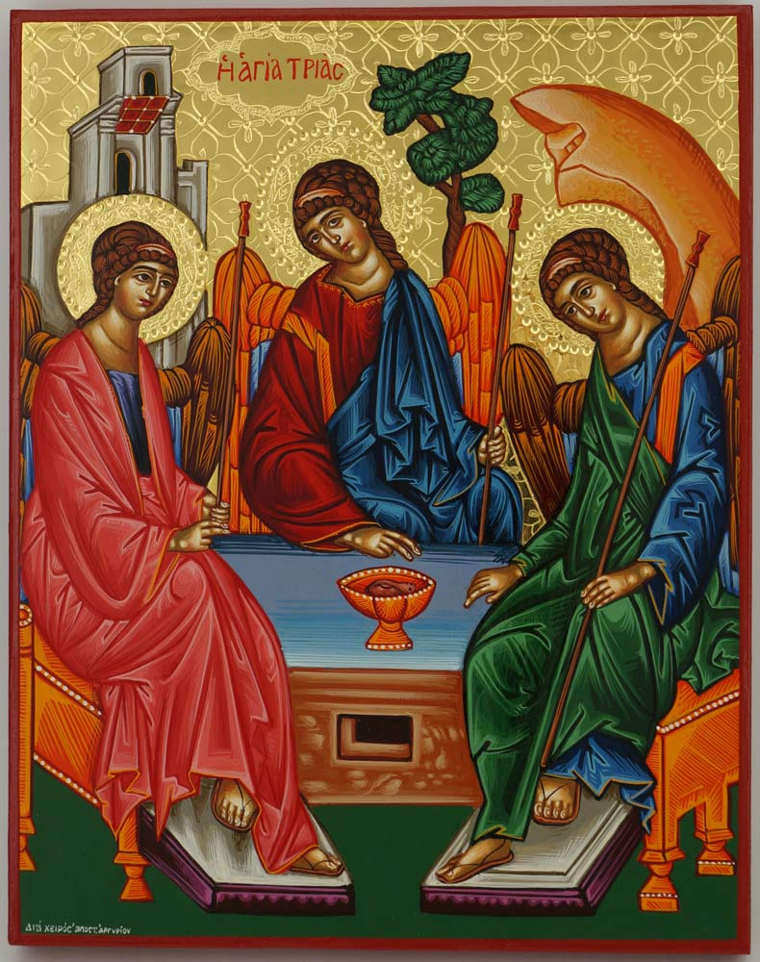
Thinking Theologically about Community
God is Community
Trinity is
Perfect Communion
The Perfection of Intimate Community
Imago Dei

Slide 17
Story- Sharing & Story-Listening
What captures your attention this time?
What stories from your community does this image Bring to Mind?

Slide 18
Bring to Mind your Neighbors
Make me to know your ways, O Lord; teach me your paths. Lead me in your truth, and teach me, for you are the God of my salvation; for you I wait all day long.
Psalm 25:4,
What words or phrases captured your attention?
How are you being led to humility?

Slide 19
Will you be my Neighbor?
Power
Vulnerability
Share
about a time when you asked this question?
about a time when you were asked this question?

Slide 20
Hold the word “Flourishing” in your heart
Make me to know your ways, O Lord; teach me your paths. Lead me in your truth, and teach me, for you are the God of my salvation; for you I wait all day long.
Psalm 25:4,5
To whom are you being called to be generous?

Slide 21
Flourishing: excerpts from “Evidence” in “Devotions,” by Mary Oliver
There are many ways to perish, or to flourish.
How old pain, for example, can stall us at the threshold of function.
Memory: a golden bowl, or a basement without life.
For which reasons the nightmare comes with its painful story and says: you need to know this.
Some memories I would give anything to forget. Others I would not give up upon the point of death, they are the bright hawks of my life.
Still, friends, consider stone, that is without the fret of gravity, and water that is without anxiety.
And the pine trees that never forget their recipe for renewal.
And the female wood duck who is looking this way and that way for her children. And the snapping turtle who is looking this way and that way also. This is the world.
And consider, always, every day, the determination of the grass to grow despite the unending obstacles.

Slide 22
Story- Sharing & Story-Listening
How is God calling You?
For what are you moved to pray?

Slide 23
Work of the People Liturgy for Life
The experience is the point
The practice is the point
The reflection is the point
The conversation is the point
The prayer is the point

Slide 24
Just one thing!

